Slide 1

The Presentation for the course of 885II 21/22 - MOBILE AND SOCIAL SENSING SYSTEMS Real-Time Vehicle and Activity Detection using Smartphone Sensors
Master’s degree program in
Computer Engineering – Computer systems and networks
University of Pisa
GROUP 10
Bruno Augusto Casu Pereira De Sousa, Kamran Mehravar
Raul Sevillano Gonzalez, Ayoub El Ourrak
1 June 2022, Pisa

Slide 2
Table of contents
1
2
Introduction
Real-Time Vehicle and Activity Detection using Smartphone Sensors :Collecting Data
3
4
Preprocessing
Machine learning
5
6
Android application
Conclusions

Slide 3
Introduction
1
Application for vehicle and activity detection
Goals
Challenges
Proposed System

Slide 4

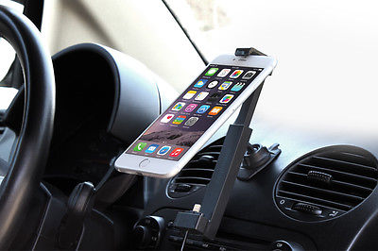

Applications for vehicle and Activity detection
Why?
Using the collected frequencies from the accelerometer data, an Android application can recognize the vehicle mode (bus, scooter, or bike) or activity (walking or running) in real time. The usefulness of the methodologies employed in machine learning development is demonstrated by the outcomes acquired with a restricted data set.
Every year, more than 1.2 million people are killed in traffic accidents throughout the world. Road traffic deaths are especially prevalent in low- and middle-income countries. In order to monitor driver and vehicle data, a variety of sensors and associated devices are pre-installed in automobiles.
The goal of this project is to develop a solution that can collect sensor data and give real-time prediction results through a smartphone app. It requires little processing resources and energy consumption, as well as the ability to respond quickly to changes in traveler vehicle modes.

Slide 5
Application for vehicle and Activity detection
Challenges
Calculating Activity and vehicle movements in real time with a reliable system.
Proposed System
Replace on-board units with a Smartphone based application.
The Smartphones can be used as an integrated platform in the fields of heterogeneous information sources and deep learning
Goals
collect sensor data and provide real-time prediction results in a smartphone application.
low computational resources and low energy consumption
to be able to respond fast to the changes of travelers' vehicle modes.

Slide 6

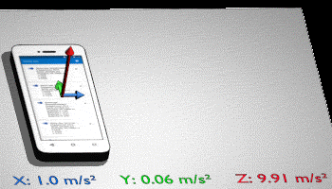
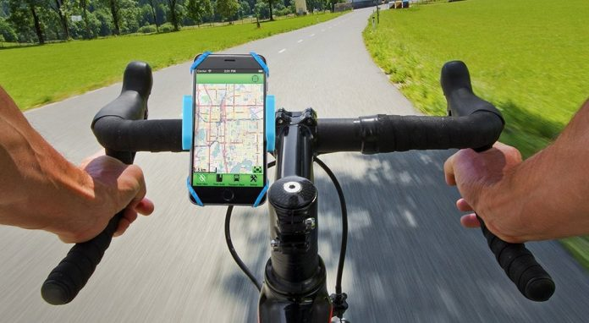

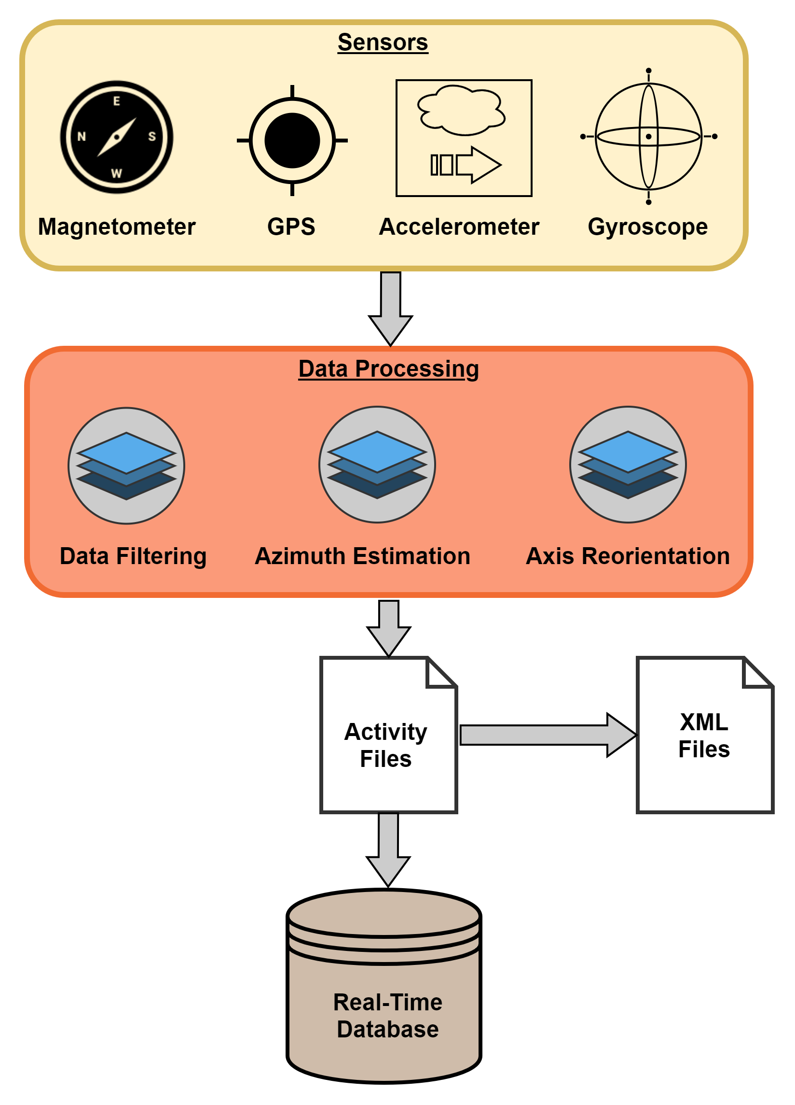
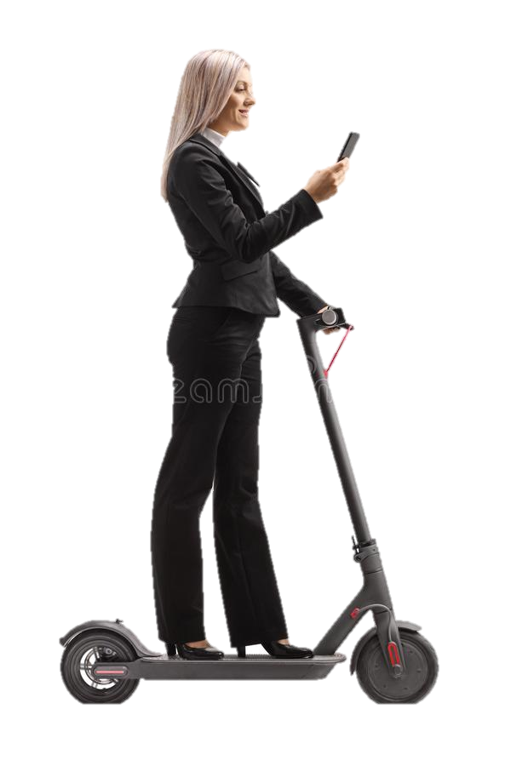
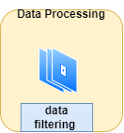


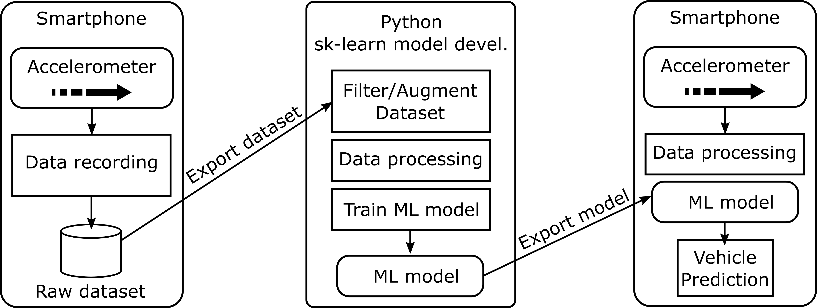
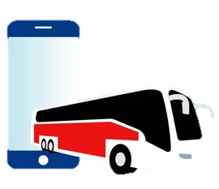

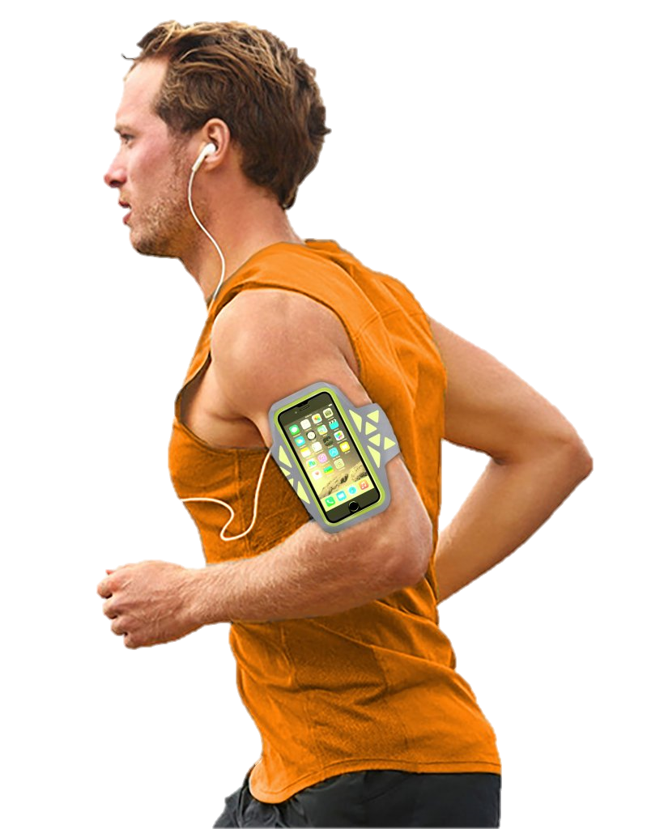
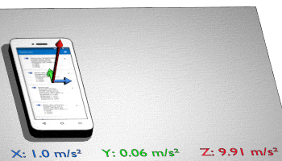
General View of our Model
Accelerometer
An Android application was developed to get the vehicle movement parameters from the Accelerometer sensor in the smartphone
Activity file

Slide 7
2
Real-Time Vehicle and Activity Detection using Smartphone Sensors
Collecting Data

Slide 8
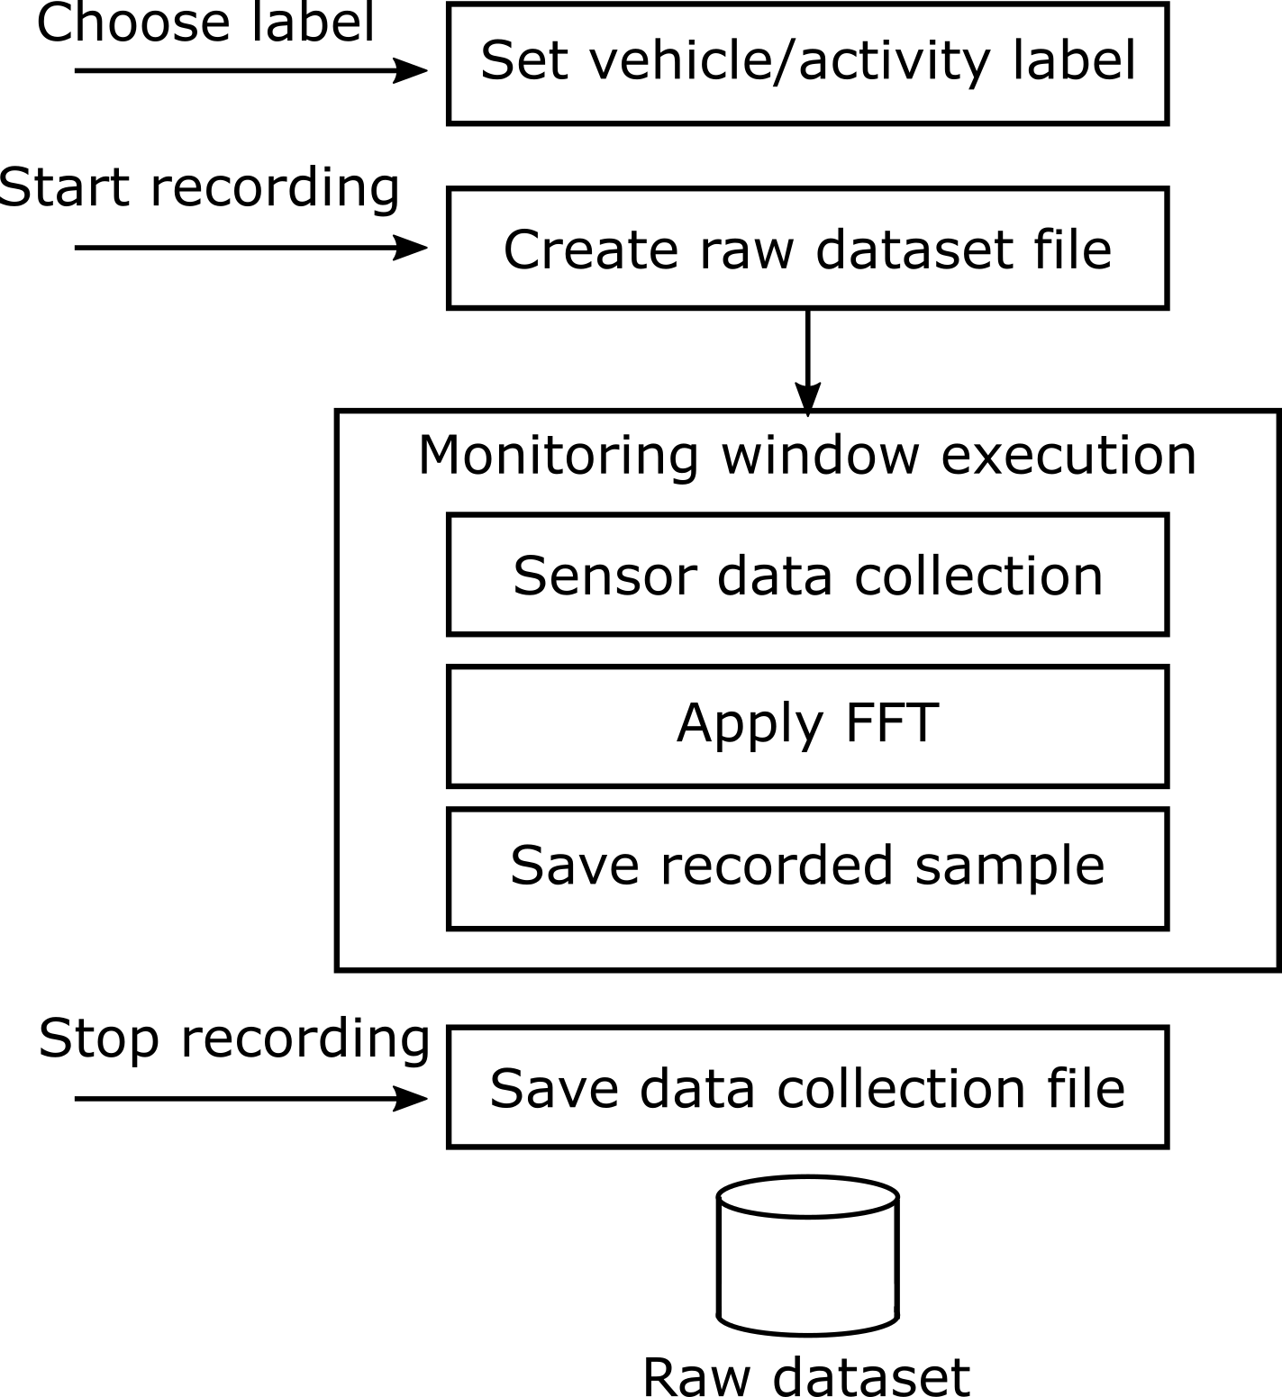
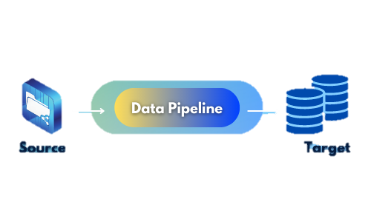
Smartphone application for car movement detection: Collecting Data
The accelerometer data may be acquired using the existing APIs on the Android platform and stored in a temporary dataset to be utilized later for ML training. The data was collected by dividing the samples into collection windows, with the program collecting and storing one frame of data for each time period.
Pipeline for data collection
When performing data collecting, the designed data collection program allows for modification of the applied overlaps. A manual setting is necessary in the code for the window size value, as this may affect how the data is saved. From the Picture depicts the data collection pipeline utilized in the application.

Slide 9
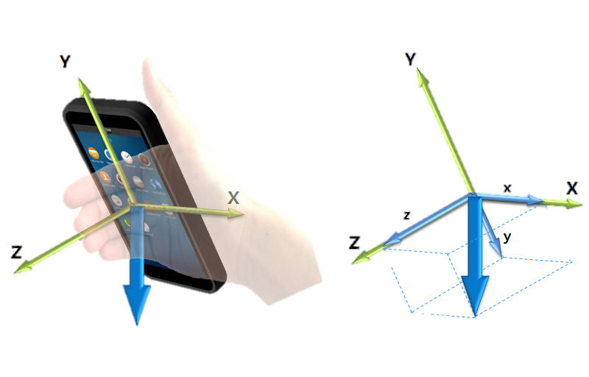
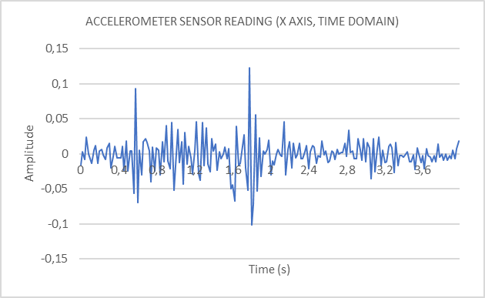
Smartphone application for car movement detection: Collecting Data
An FFT function is applied to the accelerometer data in the pipeline. This was necessary for the appropriate construction and training of the vehicle and activity detection model given. A MLP type network cannot be trained using data shown in the time domain.
Picture Below shows an example of data obtained straight from the accelerometer sensor (as supplied by the Android API):
Accelerometer sample data
The plot shows that the precise traces of the movement that the phone is making may be plotted in different parts of the axis depending on the time frame that the sensor is activated. The model does not converge to a predictive network when trained with this sort of data using an MLP.
Data collected from the smartphone
Sensor name | Description | Values
Accelerometer | Accelerationprofile of a vehicle and activity | accx, accy, accz

Slide 10

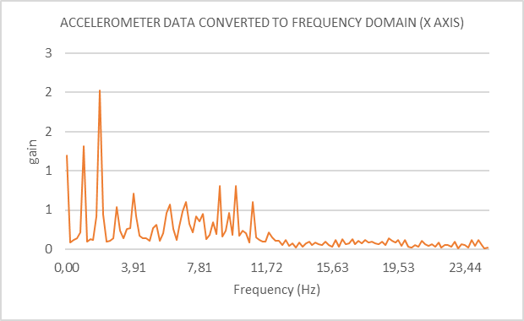
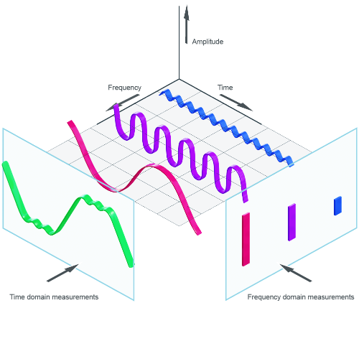

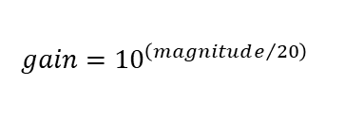
Smartphone application for car movement detection: Collecting Data
The data collection monitoring window was adjusted to 256 samples at 20 ms to speed up the FFT computation (5,12 seconds). The FFT function produces a mirrored picture with a frequency range of 0 to 50 Hz.
The data recorded contains the frequency spectrum of the x, y, and z axes. The data were concatenated and transformed to linear values for ease of usage. Another essential aspect of the data gathering is that each orientation is recorded in the same way as the previous one.
accelerometer data converted to Frequency Domain
$$gain={10}^{\left(magnitude/{20}\right)}$$

Slide 11
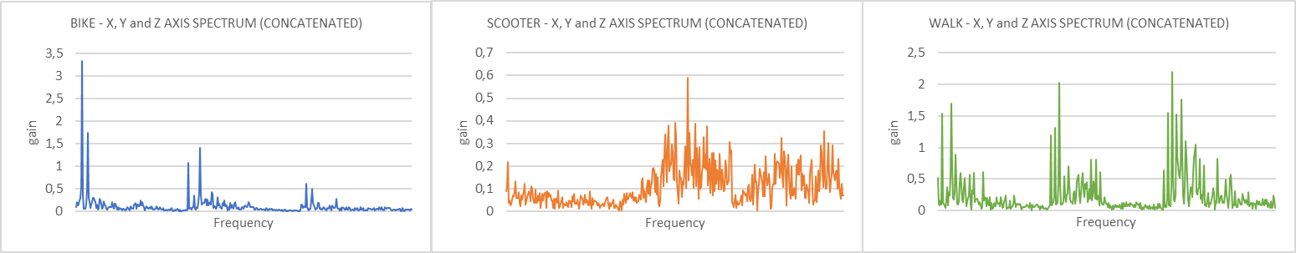
Smartphone application for car movement detection: Collecting Data
An illustration of various frequencies The plots show the signatures detected in a data collection. A varied frequency composition may be seen in the spectrum when looking at the walking plot.
Examples of vehicles frequency spectrum observed in the data collection

Slide 12
3
Real-Time Vehicle and Activity Detection using Smartphone Sensors
Preprocessing

Slide 13
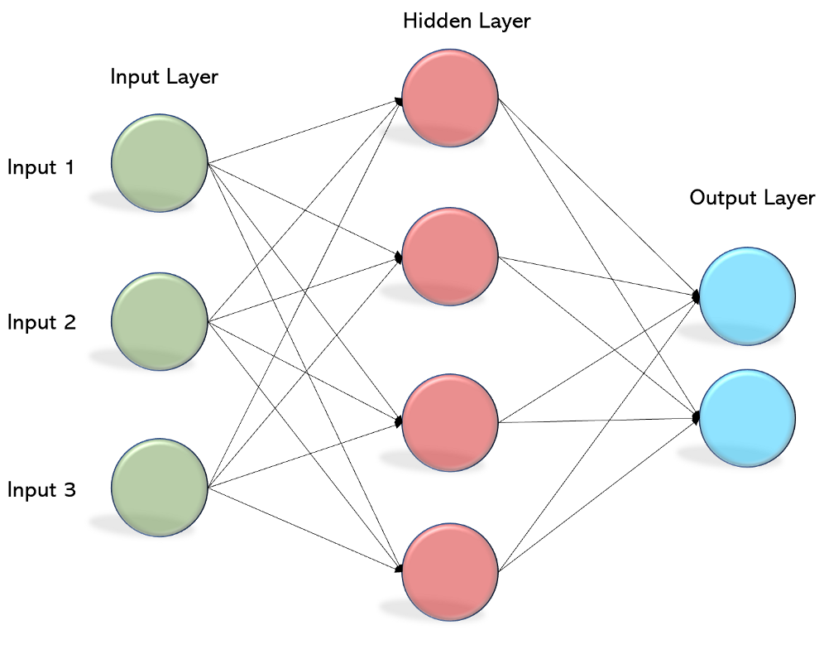
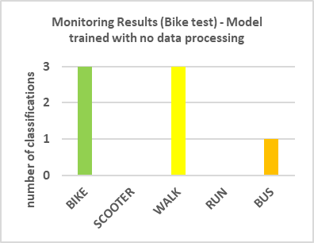

Real-Time Vehicle and Activity Detection using Smartphone Sensors: Preprocessing
An initial training of the MLP classifier model was performed using the provided frequency domain data. The model's total score was high after this initial training. However, during the monitoring tests, it was discovered that the system's effectiveness in recognizing the activity or vehicle was quite low.
Monitoring results using initial MLP
The algorithm misclassified the Bike Test as walking or even as if the user was inside a bus, according to the first data. Further study revealed that the frequency response on the various axes was the source of the misclassification. The frequency peak is shifted to another axis as the phone is positioned in a different way throughout the collection.

Slide 14
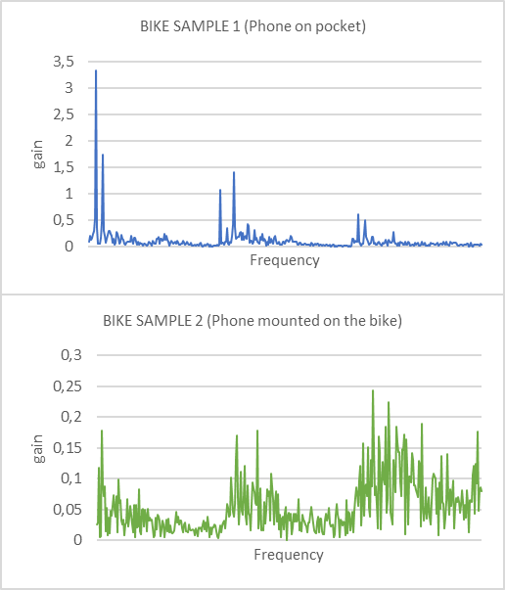
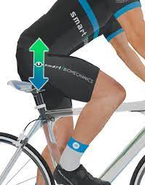

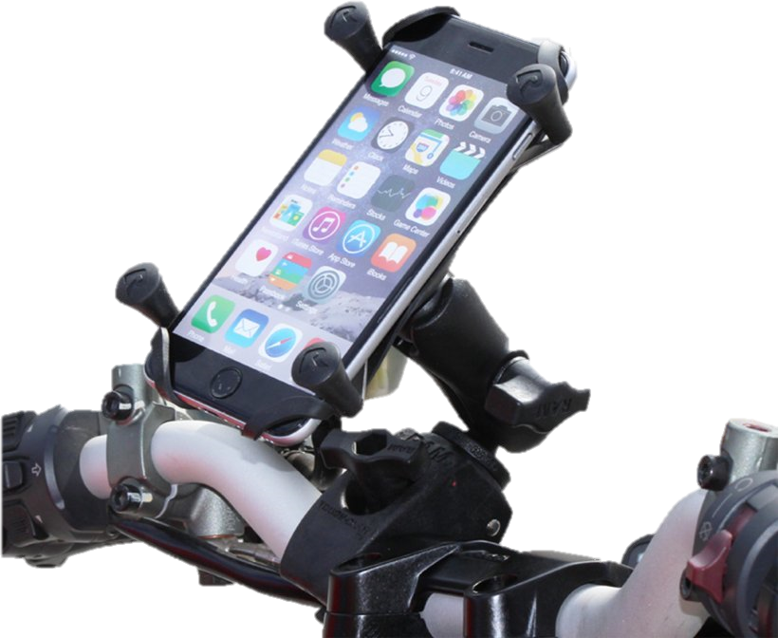
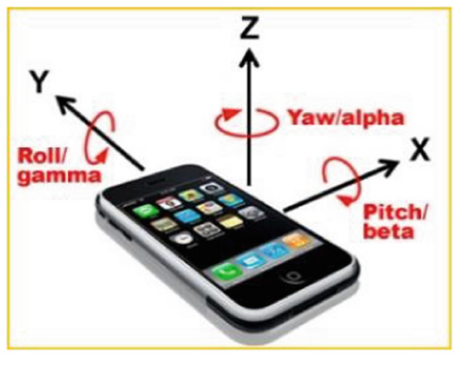
Real-Time Vehicle and Activity Detection using Smartphone Sensors: Preprocessing
Furthermore, the sample amplitudes might change greatly, making it challenging for an MLP network to train and perform adequately. From the picture depicts two data gathering methods used on a bicycle. The phone was placed in the user's pocket for the first sample, and the result is that the frequency peaks are more prominent on the X axis, with a gain of roughly 3.However, because the phone was now mounted on the Bike, the second sample peaks more exclusively on the Z axis, with a lower gain.
Examples of different frequency spectrums for the same type of vehicle

Slide 15

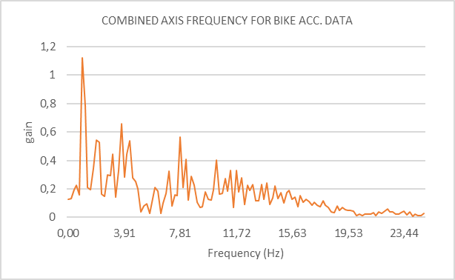
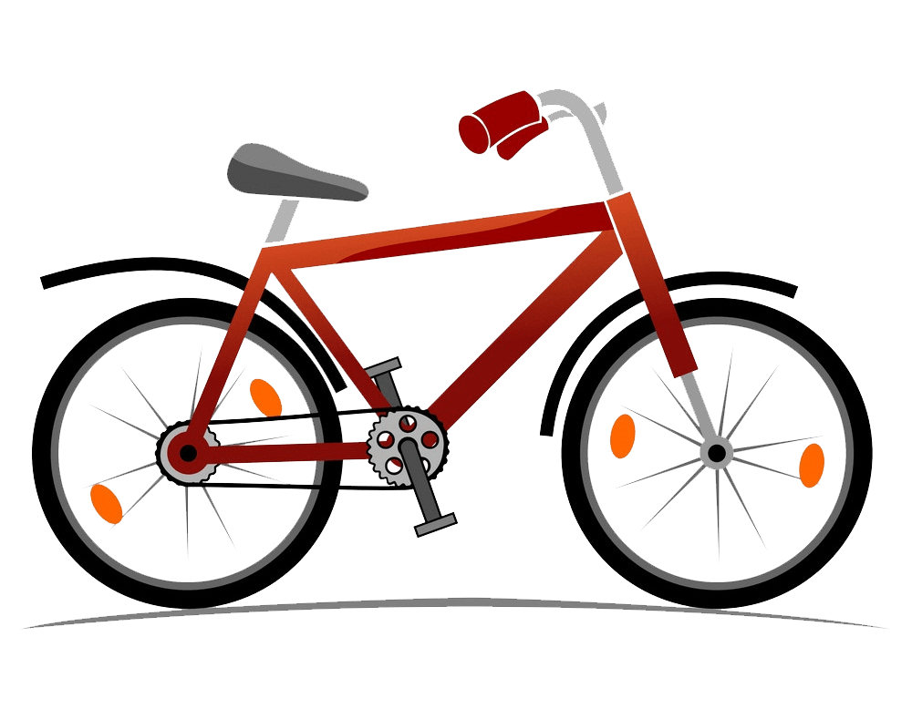
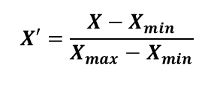
Real-Time Vehicle and Activity Detection using Smartphone Sensors: Preprocessing
Instead of processing each axis individually, the data from all axes is added together in a single array. This means that the predominant frequency (the key frequency to distinguish the vehicle mode) is being highlighted.
Combined data
A second strategy for improving the data format for ML training was utilized to complement the integration of data from the multiple axes. This is a well-known approach that involves normalizing the data, or limiting the sample's gain values to a specific range. It adjusts for samples with low amplitude but still include useful information for vehicle identification.
$$X′=\frac{X−X_{min}}{X_{max}−X_{min}}$$

Slide 16
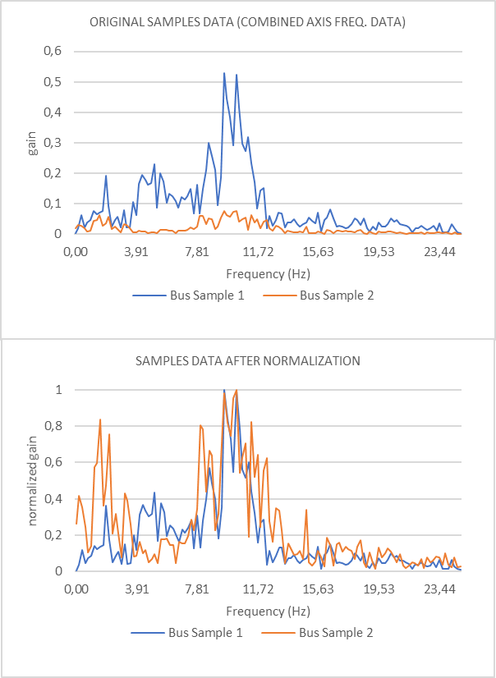


Real-Time Vehicle and Activity Detection using Smartphone Sensors: Preprocessing
The (FFT) is utilized in the MLP training process to ensure that every data used for training has a consistent maximum value. The minimum value is always zero for each reading acquired from the linear frequency data produced from the FFT conversion, while the maximum value is determined in real-time.
Original and Normalized sample data
The frequency distribution information is more important than the total gain for each frequency. On the first plot of showing Figure.
This Figure illustrates an example of the effect of normalization.
All of the strategies provided in this part for data augmentation are utilized for MLP training and monitoring, therefore the performance improvement in the generated network will be covered in the section ML Model development.

Slide 17
4
Real-Time Vehicle and Activity Detection using Smartphone Sensors
Machine learning

Slide 18



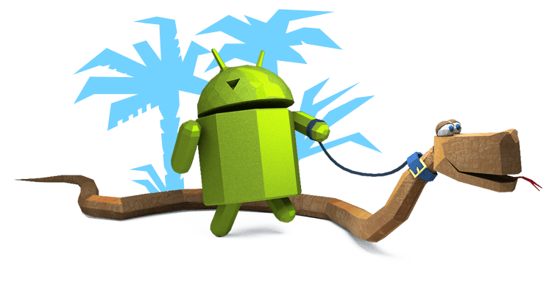
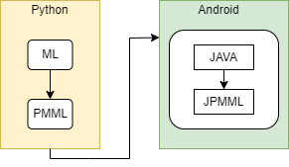
Real-Time Vehicle and Activity Detection using Smartphone Sensors: Machine learning
We can achieve a lot of benefits by using scikit-learn library in python instead of ML-kit android for our machine learning part. The main reasons we want to use Scikit-Learn are that it leads to more generality in our system and that our application will not be confined to Android.
We employed a novel machine learning technique called transfer learning on this project, and we merely transmitted the trained model as a PMML XML file to the mobile to use new data based on prior training for our conclusion. We utilized this technique instead of flask in our application due to our limits on using client and server connections.
Network model export method

Slide 19
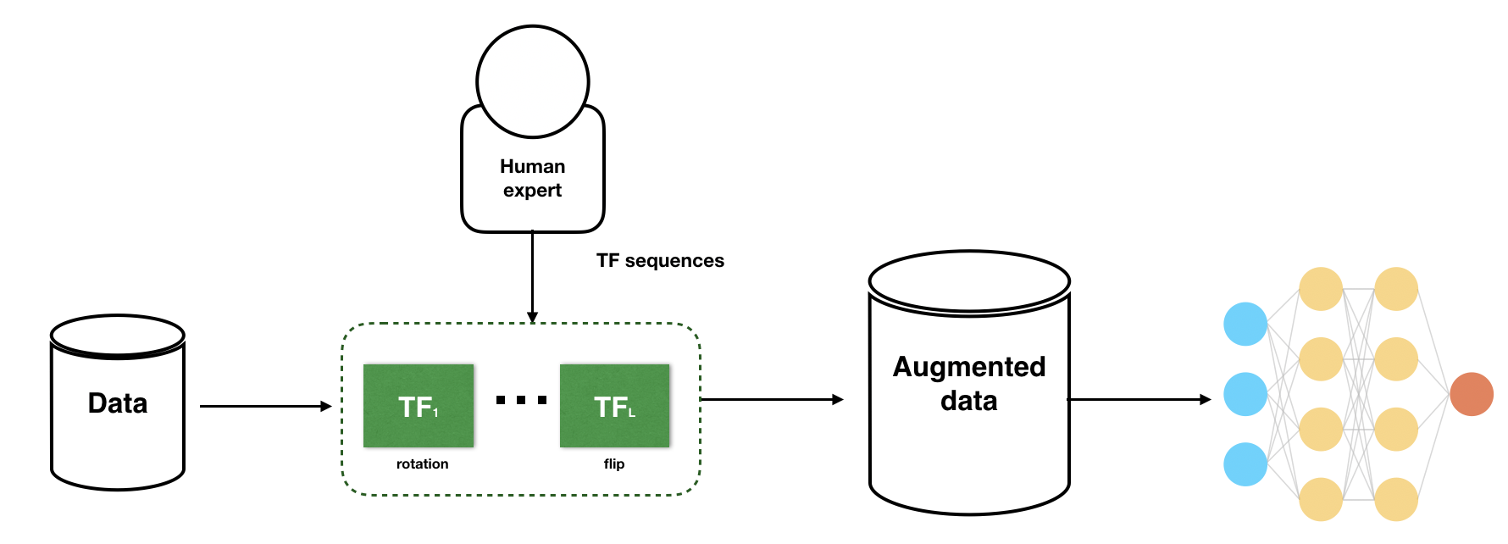
Real-Time Vehicle and Activity Detection using Smartphone Sensors: Machine learning
The main dataset used to train the model was gathered from a variety of sources. For each vehicle/activity, a total of 705, 883, 691, 1040, 364 (total: 3683) samples were collected. Using only the collected samples for initial training and testing resulted in substantially overfitted models.
When a machine learning model does not generalize effectively from training data to unknown data, it is said to be overfit. A data augmentation strategy was utilized to expand the overall amount of available data. In general, a large dataset is required for the performance of both ML and Deep Learning models.
For the time being, the augmentation procedure consists solely of inserting noise into the samples in order to generate fresh data. However, we may improve the model's performance by adding the data we already have. The extended dataset acquired at the end of this data processing stage comprises a total of 10.475 samples.

Slide 20
Real-Time Vehicle and Activity Detection using Smartphone Sensors: Machine learning
Following the enhancement, a filtering algorithm was employed to eliminate any samples with extremely low amplitude that may be deemed noise. The ML dataset used to train the network includes 10.244 samples after the filtering step.
Monitoring Result for walk and bike samples
PREDICTION | BIKE | 0,9242 | 0,0298 | 0,0275 | 0,0093 | 0,0166
 | SCOOTER | 0,0203 | 0,9468 | 0,0085 | 0,0019 | 0,0037
 | WALK | 0,0370 | 0,0000 | 0,9535 | 0,0019 | 0,0111
 | RUN | 0,0055 | 0,0043 | 0,0000 | 0,9870 | 0,0055
 | BUS | 0,0129 | 0,0191 | 0,0106 | 0,0000 | 0,9630
 |  | BIKE | SCOOTER | WALK | RUN | BUS
 |  | TRUE LABEL
The model was trained with a maximum of 100 iterations and only one layer of 100 neurons (default config from sk-learn MLPClassifier network). This training yielded a total accuracy score of 95.5 percent, based on the assessment of over 2.000 samples. The following confusion matrix was created as a result of the research:

Slide 21
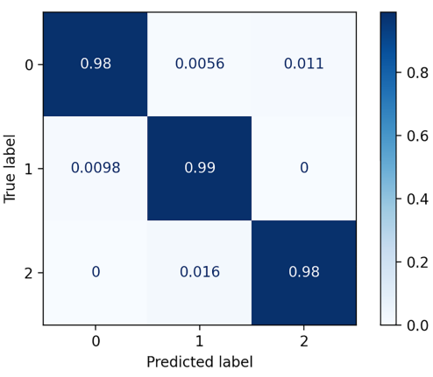
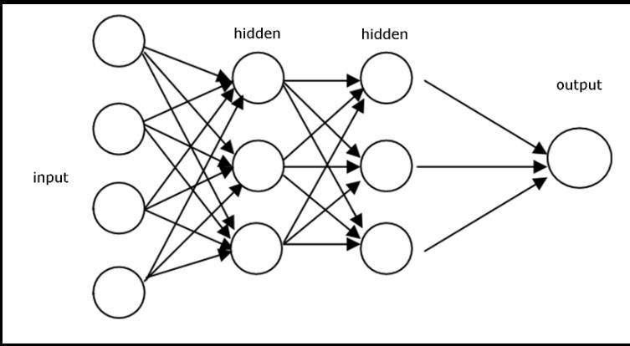
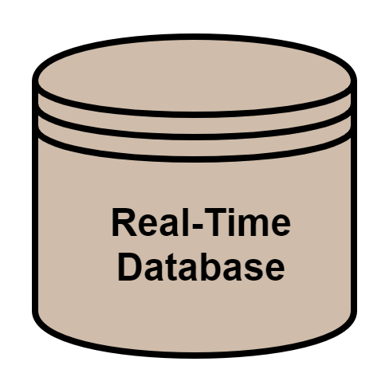

Smartphone application for car movement detection
Lane Changing Classification
Left lane changes
From the collected sensors and features run a Feature Extraction algorithm (K-Fold cross-validation)
gyroy, accy, difference, magnitude, and pitch as our features for lane change detection.
The raw dataset that was 57 left lane changes, 37 right lane changes, and 938 non-lane changing instances.
Balancing the dataset with adaptive synthetic (ADASYN) oversampling.
Right lane changes
Lane keeping instances
Classifier (Feed Forward NN)
Sensor data and preprocessed data
Feature Extraction
Lane changing Labels

Slide 22
5
Real-Time Vehicle and Activity Detection using Smartphone Sensors
Android application
Data Collection
Monitoring
Application compatibility and permission

Slide 23
6
Real-Time Vehicle and Activity Detection using Smartphone Sensors
Conclusions

Slide 25


Slide 26
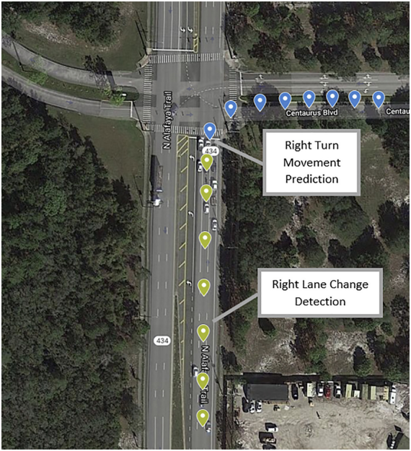
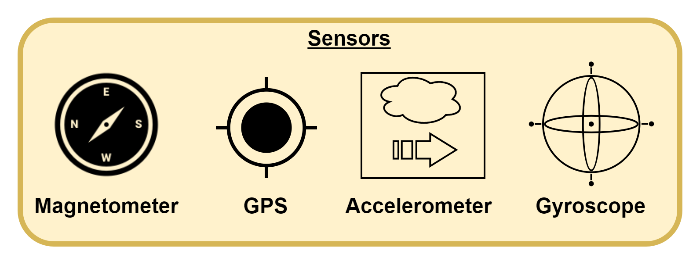
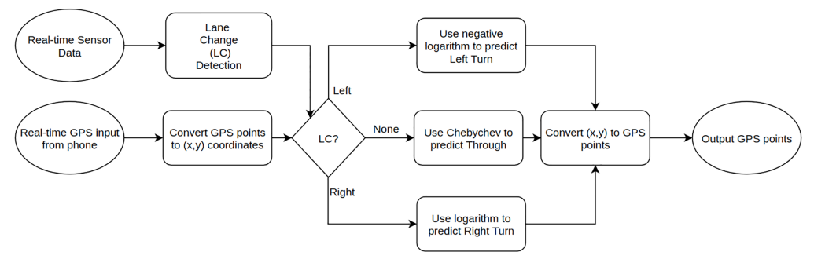
Flowchart of the System

Slide 27
Application Scenarios and Conclusion
4

Slide 28
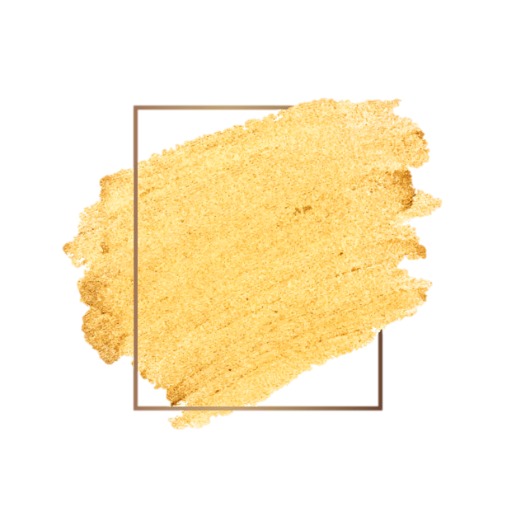
Application Scenarios and Conclusion

Slide 29
Application Scenarios and Conclusion
The vehicle movement detection system is applicable to intersections with a large volume of turning vehicles as well as streets with a high number of pedestrians
Parameters like time-to-collision can be calculated based on trajectory prediction to identify the safety concerns at an intersection, avoiding accidents.
For the vehicles with lower levels of automation, such mobile-based systems could be a way to achieve partial automation.
As the developed application does not need external sensors (all data is collected and processed by the smartphone), the system then is cost-efficient, simplistic, and user-friendly, with the potential for high market penetration.

Slide 30
That’s All Folks!!!

Slide 31
References:
https://journals.sagepub.com/doi/10.1177/0361198121990681>
https://www.researchgate.net/publication/333655827_Signal_Processing_and_Conditioning_Tools_and_Methods_for_Road_Profile_Assessment>
https://ieeexplore.ieee.org/document/9459688
https://www.mdpi.com/1424-8220/18/4/1036?type=check_update&version=2>

Slide 32
BACKUP SLIDES

Slide 33
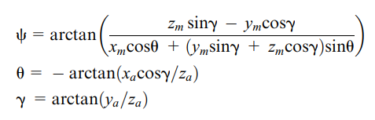
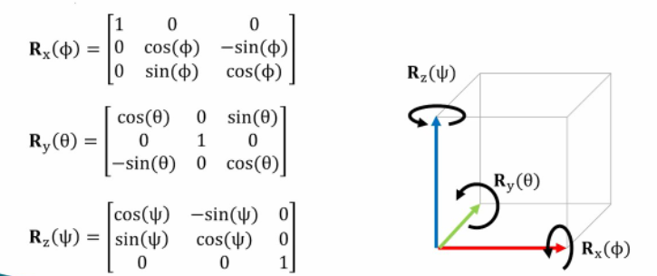
Accelerometer readings (xa, ya,za) together with
the magnetometer readings (xm, ym,zm)
Azimuth angle calculation (where teta is the pitch, and gama is the roll.)
Azimuth angle (used to detect the lane change)
Rotation matrix calculation
phy = gama
MOVEMENT IS IN THE x AXIS DIRECTION

Slide 34
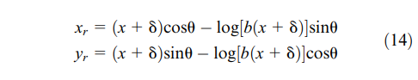
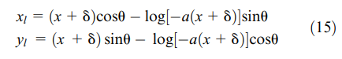
Trajectory computing equations:
Right Turn Movement logarithm equation
Left Turn Movement logarithm equation

Slide 35
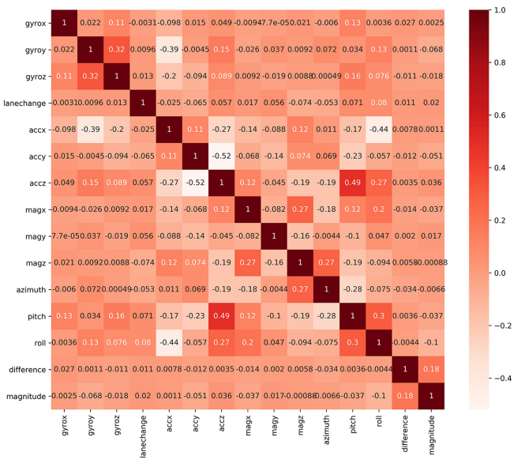
Feature extraction – correlation table of the gathered data:

